Slide 1

Mobility Solutions for the 21st Century
By: Aad van der Wijngaart
Ivor Jonker
Ish Ramautarsing
Koen van Lieshout

Slide 2
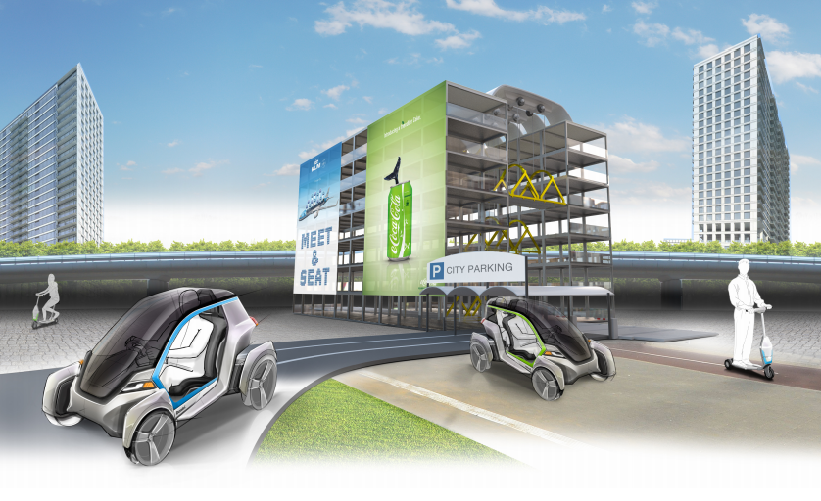
The Transition Hub

Slide 3

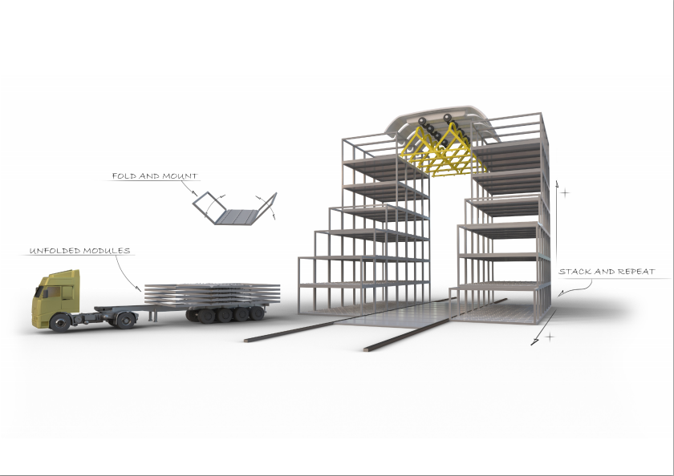
Flexible and Modality
Cheap & Easy to Build and Dismantle
Modality: usable for a wide area of activities, such as housing, offices.

Slide 4
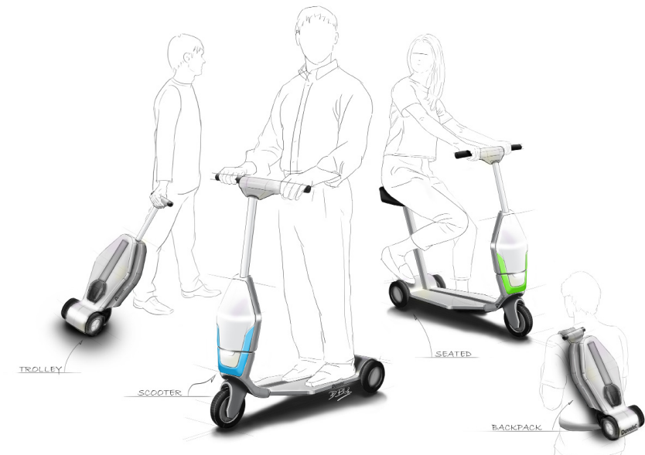
The Transition Hub
The Wheelie
Last mile purpose
Portable design
Used for inner-city transport

Slide 5
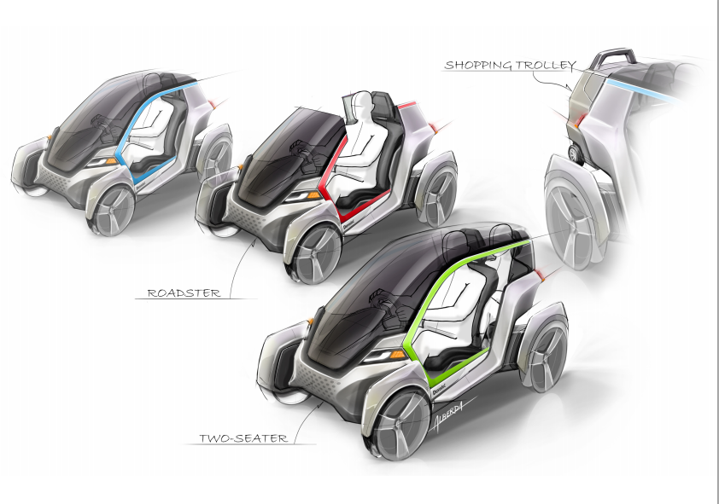
OlegO
Pedestrian Lane Parking
Parking to Destination Purpose

Slide 6
Inner-city mobility in 21st century
Paper on Working, Living, Consuming
Increasing agglomeration
Increasing importance of centre’s livelihood
Increasing importance of ‘city responsibility’ towards environmental issues
Cities face mobility challenges as well as mobility opportunities

Slide 7
Problem statements
Congestion issues causing economic losses
CO₂ emissions causing climate change
Mobility management causing efficiency losses
Smog & particulates causing health problems
Economic losses estimated at € 0.67 per km.¹
¹ Calculated in Copenhagen.

Slide 8
Solutions
Integral solution; rethinking mobility from beginning to end
Realisation possible within current infrastructure
Economically feasible
Strategically desirable
Environmental impact

Slide 9
Practical proposals: The Transition Hub
Flexible parkings
  Modular building process
  Strategical positioning
  Superior building structure
Wheelie
  Portable design
  Last mile purpose
OlegO
  Pedestrian lane parking
  Parking to destination purpose

Slide 10
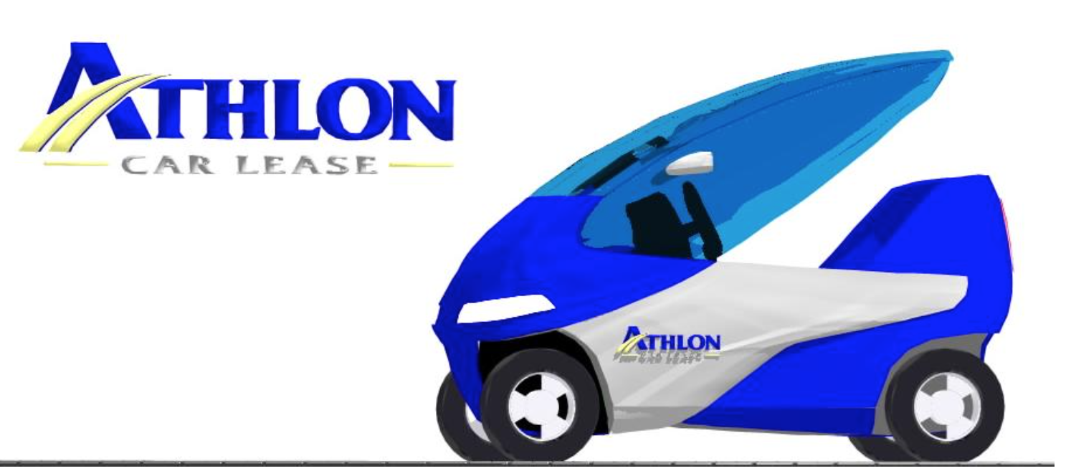
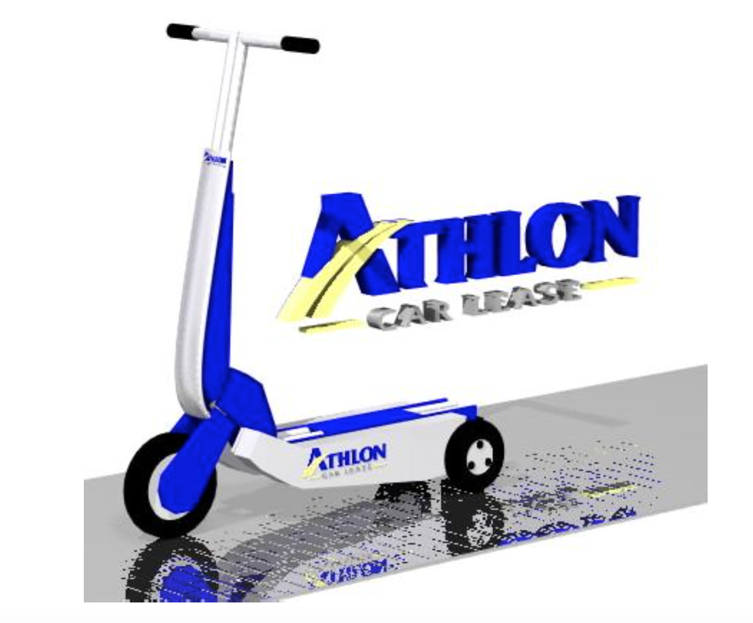
Product development
OlegO
Wheelie

Slide 11
Characteristics of solutions
Strengthen Rotterdam’s leadership in logistics
  Port of Rotterdam
  Erasmus University Rotterdam
  Entrepreneurship in Rotterdam
  Citizens of Rotterdam
Structural innovation
  Catalyzes product and service innovation
  Needs a strong, supporting backbone

Slide 12
Research team
Ivor Jonker (Student MSc Entrepreneurship & Strategy Economics, Erasmus University)
Ish Ramautarsing (Student MSc International Economics, Erasmus University
Koen van Lieshout (Student MSc International Economics and LLM International Commercial and Company Law, Erasmus University)

Slide 13
Research team
Team Leader:
Aad van der Wijngaart (Van der Wijngaart’s Engineering Services)
  Research Supervisors:
Roy Thurik (Prof. Dr. Economics and Entrepreneurship)
Peter van der Zwan (Dr. Applied Economics)

Slide 14
Analysis
Financial Analysis
  Estimation of financial attractiveness of the project
Entry Strategy Analysis
  Determination of strategic locations and price determination of the Transition Hub
External impact Analysis
  Influences contributing to societal efficiency and fortunate environmental developments

Slide 15
Conclusions
Financially feasible
Several optimal locations identified outside the inner-city for the Transition Hub project implementation
Revolutionairy new way of designing city mobility with comprehensive Transition Hub
Reduction of 20-50% of CO2 and particulates emissions in the inner-city

Slide 16
Financial Feasibility
Comprehensive research conducted to estimate/predict financial results for project (life expectancy = 20 years):
  Cash Flow Analysis (estimated cash in-and outflows)
  Scenario Analysis (assess possible unfavorable scenarios)
  Sensitivity Analysis (assess possible volatility in parameters)
General remarks
  Transition Hub cheaper to build relative to conventional parkings
  In mobility industry initial investments are large but this project is of durable (>20 years) and sustainable nature
  Disrupting market with project can possibly lead to large growth potentials and innovation

Slide 17
Financial Feasibility
Results: Financial indicators
  IRR: 13% (benchmark similar projects: between 10% and 20%)
  Net Present Value: €2,986,336.43
  Payback Period: 7.9 years (reasonable)
Conclusion: Project is financially feasible and thus attractive in financial terms
*Remark:
Financial results strongly depending on finance costs → Financial resources should be low
Revenues strongly depending on short-term parking customers → innovative transition hub requires optimal promotion

Slide 18
Strategic desirability
Strategic desirability
  Price superiority
  Distance superiority
  Time superiority
Location desirability
  In line with zoning policies
  At points of congestion
Market desirability
  Need for innovation in rusty market

Slide 19
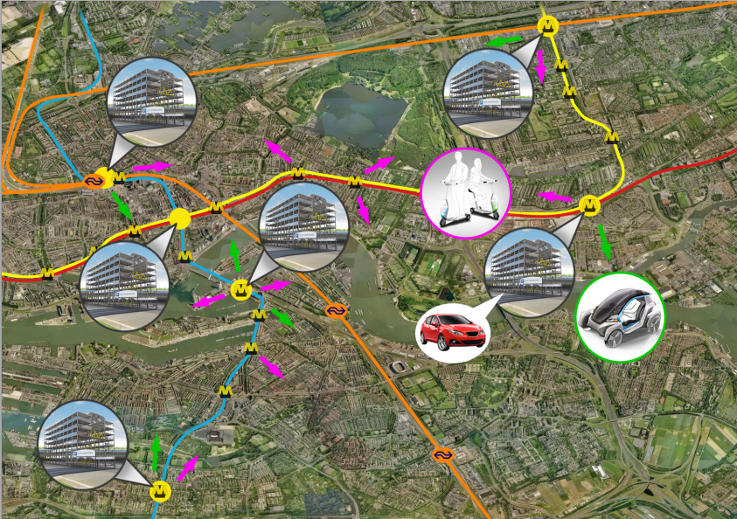
Strategic desirability

Slide 20
Environmental impact
Road pressure diminishes
CO2 emission lowers
Particulates emission lowers
Better throughput of cars
Usage of electrically powered vehicles
Catalyzation of transport innovations

Slide 21
Economic impact Rotterdam
Substantial reduction in congestion issue
  Causes inner-city dispersion of traffic
Reduction in CO₂ emission
  Project promotes use of electric vehicles
Reduction on occupied land area for parkings
  Savings on highly desired land space (downtown) which can be used to exploit favorable business opportunities

Slide 22
Global impact
Transition Hub concept ready for implementation on large, global-scale
  Attractive for metropolitan areas with lots of congestion and mobility issues
  Governments continuously attempt to improve mobility and efficiency of land area usage
  Businesses profit from mobility advances and can reap benefits from the spillover effects of innovation

Slide 23
Product development
Developing Wheelie and OlegO for commercial use
Raising funds to facilitate the project
Test on small scale with a Transition Hub and techonological adittions(apps)
Fully implementing Transition Hub Rotterdam

